Slide 2
Token Customization

Slide 3
Why customize token?
Drive authorization decisions in your applications and APIs
Light up different parts of the application

Slide 4
Claims Mapping vs Optional Claims
Optional Claims
Claims Mapping
Generic information that every tenant can have, with a defined schema
Applies at an application registration level, controlled by app developer
Tenant-specific information (e.g. EmployeeID or DivisionName) that has no schema
Applies at a service principal level, controlled by admin
Useful for moving LOB apps to the cloud
Custom Claim Provider

Slide 5
What can you customize?
ID Token
Access Token
Intended for the client application.
The request to customize goes in the client application registration.
Intended for the API.
The request to customize goes into the API registration.

Slide 6
Demo Adding Optional Claims

Slide 7
Using groups for authorization

Slide 8
Security Groups
Not tied to an app, groups can be used in multiple apps and for other access control purposes
Cloud only groups provide only the group ID in the token
On-Prem groups can use group name instead
On-Prem nested groups supported. Every group tier in the token
Selecting Application groups will result in only groups the user is a member of that have been assigned to the app will be in the token
Nested groups not supported for Application groups
Groups can optionally be represented in the “roles” claim
Configure group claims for applications with Azure Active Directory

Slide 9
Demo Configure Group Claim

Slide 10
Groups overage
Groups claim limited to 200 groups for JWT tokens
Groups claim limited to 150 groups for SAML tokens
Groups claim limited to 6 groups when using the implicit flow
Implicit flow not recommended for SPAs
Implicit flow used in web apps (hybrid flow)
Apps must implement Microsoft Graph based group membership checking when configured for groups claim in the token

Slide 11
Token with overage Emitted when a user is member of more groups than the overage limit 200 for JWT tokens 150 for SAML tokens
{
"aud": "19a7ff3f-24fd-40ba-884b-f00e00179fdf",
"iss": "https://login.microsoftonline.com/72f988bf-86f1-41af-91ab-2d7cd011db47/v2.0",
"iat": 1563966830,
"nbf": 1563966830,
"exp": 1563970730,
"_claim_names": {
"groups": "src1"
},
"_claim_sources": {
"src1": {
"endpoint": "https://graph.windows.net/72f988bf-86f1-41af-91ab-2d7cd011db47/users/32fe213d-e4d1-4973-96f9-1901ec32a16c/getMemberObjects"
}
},
"aio": "AWQAm/8MAAAG29wflVSWrAYPL8T",
"name": "Kalyan Krishna",
"oid": "32fe213d-e4d1-4973-96f9-1901ec32a16c",
"preferred_username": "kkrishna@microsoft.com",
"sub": "mPkIo6qb0M8qYT5ULpqXJscrKhWkz-FecFsRA4NeH8w",
"tid": "72f988bf-86f1-41af-91ab-2d7cd011db47",
"uti": "38iX3BfTa0S3IOKfdLoJAA",
"ver": "2.0"
}
Don’t use

Slide 12
Groups overage claim- Implicit flow
The overage indication and limits are different than the apps using other flows.
A claim named hasgroups with a value of true will be present in the token instead of the overage (_claim_names) claim .
The maximum number of groups provided in the groups claim is limited to 6 (six). This is done to prevent the URI fragment beyond the URL length limits.

Slide 13
Steps to process groups claim
Check for:
the claim _claim_names with one of the values being groups.
The hasgroups claim
These indicates overage.
If found, make a call to https://graph.microsoft.com/v1.0/me/transitiveMemberOf to fetch user’s groups.
This requires an access token for Graph with the User.Read permission
If none found, look into the groups claim for user’s groups.

Slide 14
App Roles for Users and Groups

Slide 15
App Roles
Used to assign permissions to users and groups
Specific to the application
How to: Add app roles in your application and receive them in the token

Slide 16
Demo App Roles assigned to Users
http://aka.ms/approles

Slide 17
Id_token with groups and roles
App roles for users
Roles in a token will be provided in the “roles” claim
{
"aud": "300e33f5-e62e-4581-acd2-542ece0965cc",
"iss": "htps://login.microsoftonline.com/536279f6-15cc-45f2-be2d-61e352b51eef/v2.0",
"iat": 1563969244,
"nbf": 1563969244,
"exp": 1563973144,
"aio": "AeQAG/8MAAAAYPOQy4ROQXwGbt+LpH37Q8I=",
"groups": [
"MSDemoUsers"
],
"name": "Kalyan Krishna",
"nonce": "6369956633167913NDUwODI0",
"oid": "98d51ac8-a756-43ef-876f-e7e64c89b323",
"preferred_username": "kkrishna@contosoorg.net",
"roles": [
"DirectoryViewers"
],
"sub": "bGcfwO94xuVM7Dv-O62Bb76ZlB9RzHa0R-48jtQgKgg",
"tid": "536279f6-15cc-45f2-be2d-61e352b51eef",
"uti": "WQBn7mDb2UygvE7fPrIfAA",
"ver": "2.0"
}

Slide 18
Should you really be customizing your tokens?
Tokens are valid until they expire
ID Tokens can be one hour out of date
Access Tokens can be 28 hours out of date
Groups in tokens are limited to 200, 150 or 6 groups
And you get a list of groups, many of which are “noise”
Microsoft Graph is always up to date
Microsoft Graph can handle any number of groups
Tokens may be a good choice for ISVs

Slide 19
Demo Using Microsoft Graph instead of tokens

Slide 20
Custom Claim Provider
Data that you can’t get from Microsoft Graph

Slide 21
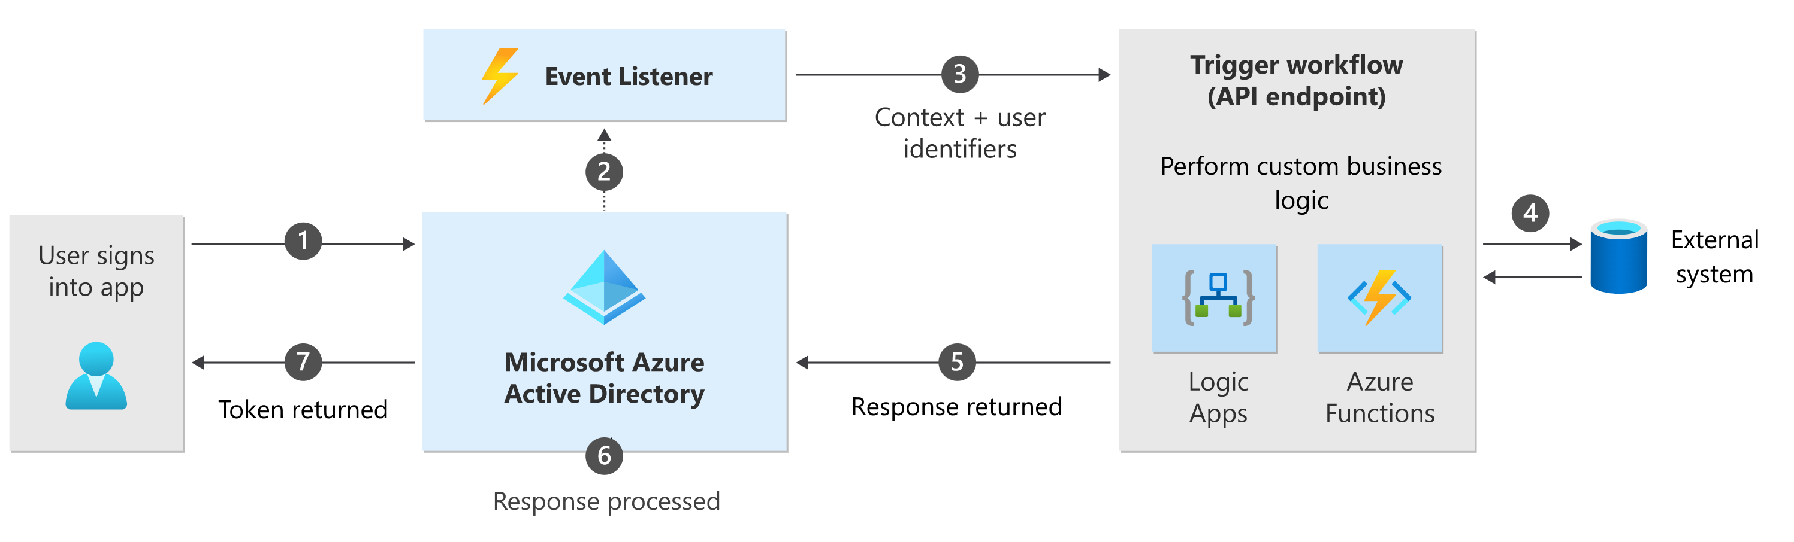
Custom authentication extensions
https://aka.ms/IDDevCustomAuth

Slide 22
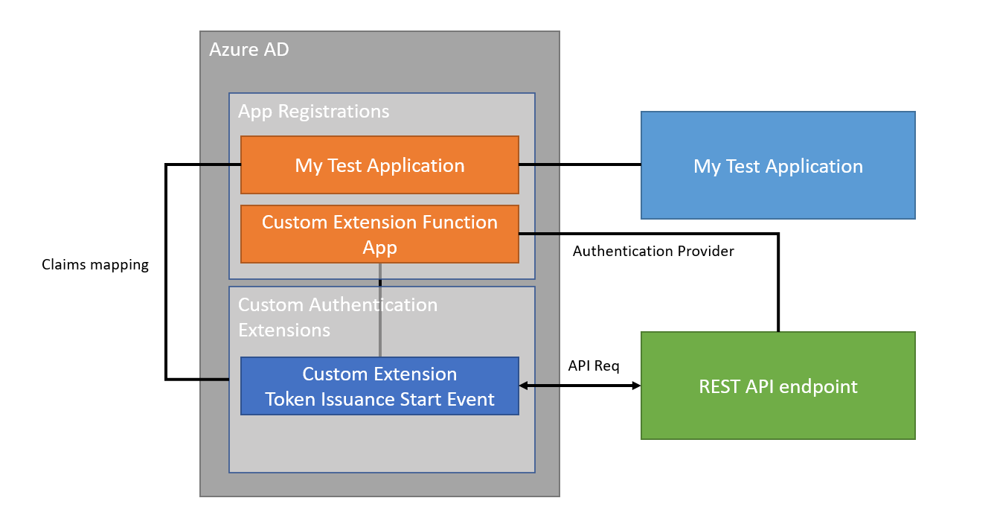
Token issuance start event (Only one so far ☺)

Slide 23
Demo Single Sign On – Attributes and claims

Slide 24
Questions?

Slide 25
Thank you

